Slide 1
ROMAN KNOWLEDGE (part one)
TOMAS NICHOLS

Slide 2
Introduction
Romans lived in Italy about 2000 years ago
They started as farmers then grew rich and powerful
Rome was built as a beautiful city
Legend says that Rome was built by Romulus the twin brother of Remus who (sons of Mars the Roman God of War). They were rescued by a wolf and brought up by her

Slide 3
Rome
In 50 BC almost one million people lived in Rome
Some residents were born in Rome but many others travelled to search for work
Rome was the centre the Roman Empire where the government, Emperor and law were all located
Some romans boasted about one phrase:
“ All roads lead to Rome”

Slide 4
Roman Citizens
Rulers of Rome
At first there were Kings, then officials in a Republic and finally Emperors
There were different ranks of people in Rome:
Rich families called Patricians
Middle rank called Equites
Ordinary people called Plebians
Slaves owned by the rich

Slide 5
WHAT DID THE ROMANS DO FOR ENTERTAINMENT?
The romans had many things as entertainment such as singing, dancing and plays.
The most popular entertainment was gladiator fighting and chariot racing.
Chariot racing was held in a vast sports arena called the Circus Maximus.

Slide 6
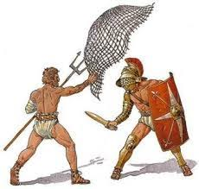
GLADIATORS
Gladiators were usually prisoners, Christians or slaves forced to fight till they die.
There were three types of gladiators:
Reticulares – armed with nets and tridents
Vilites – threw spears at each other
Bestarii – they fought animals (snakes, lions and bears)

