Slide 1
HADRIANS WALL
TOMAS NICHOLS
4/5/2020

Slide 2
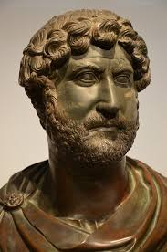
WHO WAS EMPEROR HADRIAN?
WAS BORN IN ROME IN 76AD AND DIED IN 138AD
HE RULED THE ROMAN EMPIRE FOR 21 YEARS (117AD TO 138AD)
HIS MISSION WAS TO STRENGTHEN THE ROMAN EMPIRE AND EXPAND IT
HE VISITED BRITAIN IN 122 AD AND WAS THOUGHT TO ORDER THE WALL TO BUILT THEN

Slide 4
FACTS ABOUT HADRIAN’S WALL
IT TOOK FOURTEEN YEARS TO COMPLETE BETWEEN 122AD AND 136AD
IT WAS 110 KM ACROSS BETWEEN SCOTLAND AND ENGLAND ALONGSIDE THE RIVER TYNE
IT WAS 4.50 M TALL AND 2.75M WIDE
IT WAS BUILT BY 3 LEGIONS OF ROMAN SOLDIERS
IT WAS BUILT TO PROTECT THE ROMAN COLONY FROM THE SCOTTISH AFTER THEY HAD INVADED BRITAIN
EVERY MILE THERE WAS A CASTLE ON THE WALL TO CONTROL PEOPLE CROSSING INTO BRITAIN
16 FORTRESSES WERE ALSO BUILT ALONG THE WALL

Slide 5
HOUSESTEAD FORTRESS, HEXHAM NORTHUMBERLAND
ROMAN TIMES
TODAY

Slide 6
HADRIANS WALL TODAY

