Slide 1
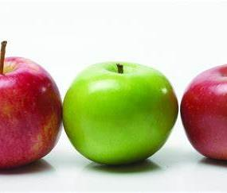
Apples Achievements
April 2020
From Mrs Down x

Slide 2
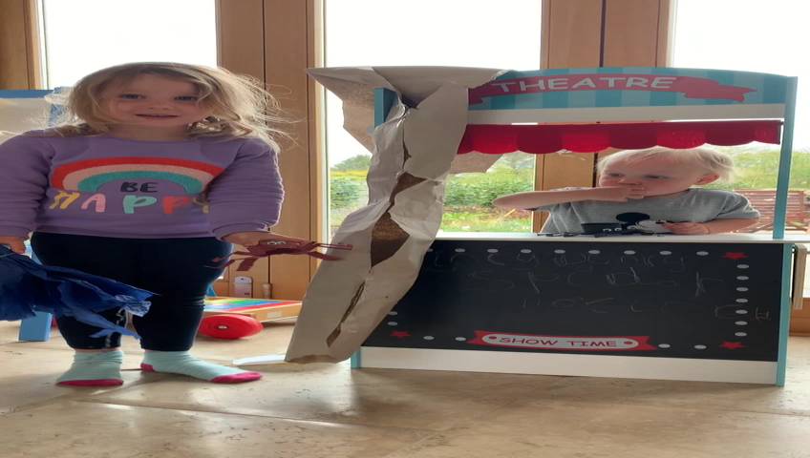
Amelia did a show for you all

Slide 3
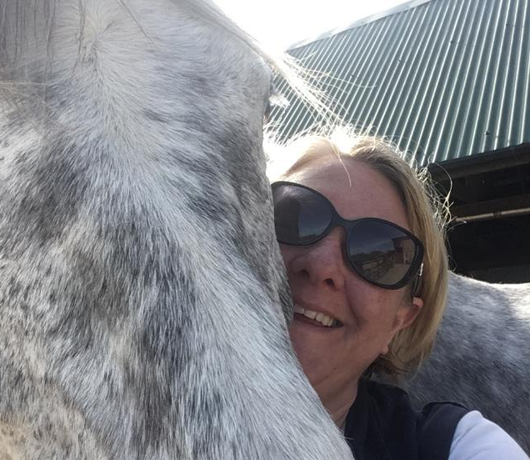
Thank You!
Love Mrs Down

