Slide 1
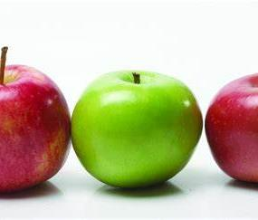
Apples Achievements
April 2020
From Mrs Down x

Slide 2
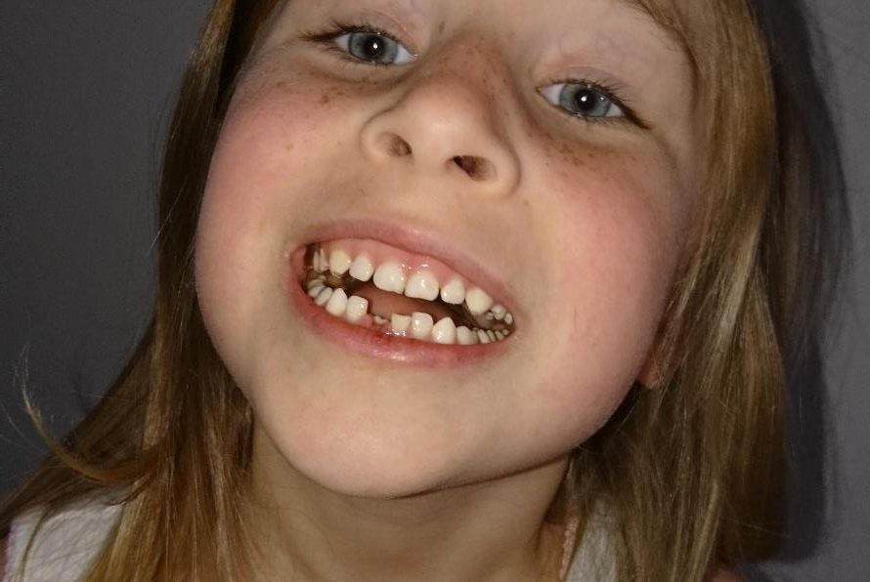
Other news
Evelyn has lost a tooth!

Slide 3
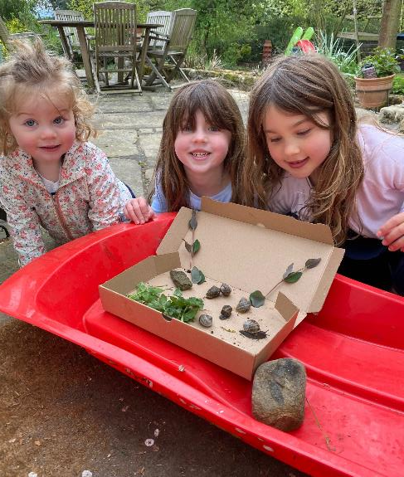
Lulu and her pets
Frogs and snails!
Lulu has some pet frogs in her garden which get bigger every day.
She has some pet slugs and snails too – her favourite is called turquoise
She has had a visit from a tawny owl – what a shame it was poorly

Slide 4
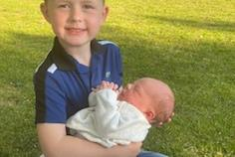
Congratulations
Many congratulations to Arthur and his family on the safe arrival of Albert. I cannot wait to meet him!

Slide 5
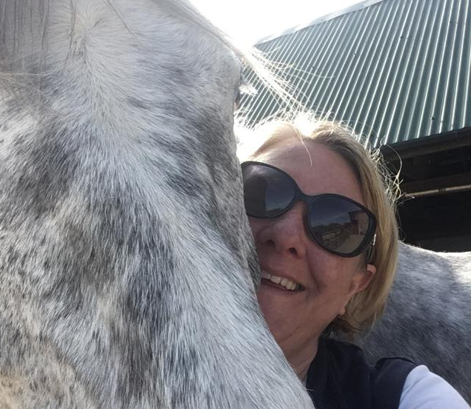
Thank You!
Love Mrs Down

