Slide 1
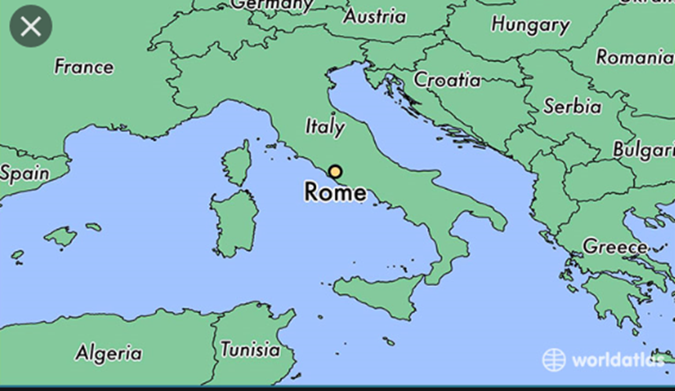
ROMAN GODS
BY GEORGIA

Slide 2
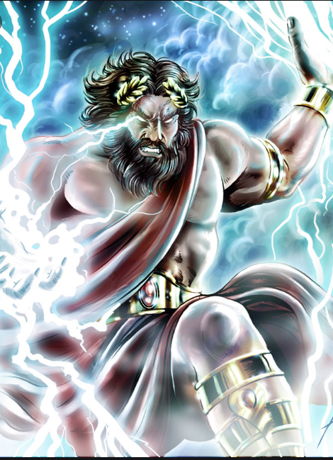
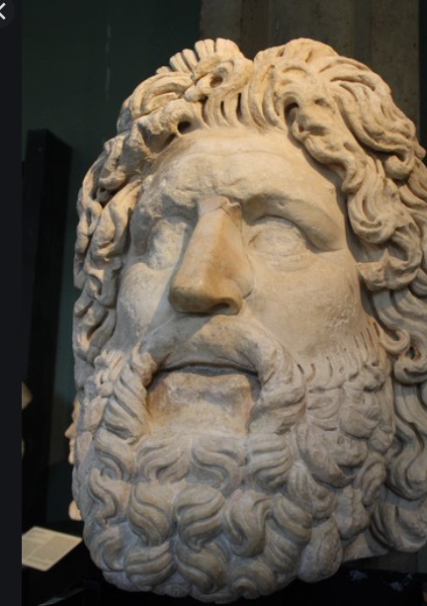
JUPITER
Roman myths say Jupiter is the king of gods . He is also god of the sky . In Greece he is called Zeus.

Slide 3
JUNO
Juno is the queen of gods and is the goddess of love and marriage . She has 4 children , Mars, Vulcan, Bellona and Juventus

Slide 4
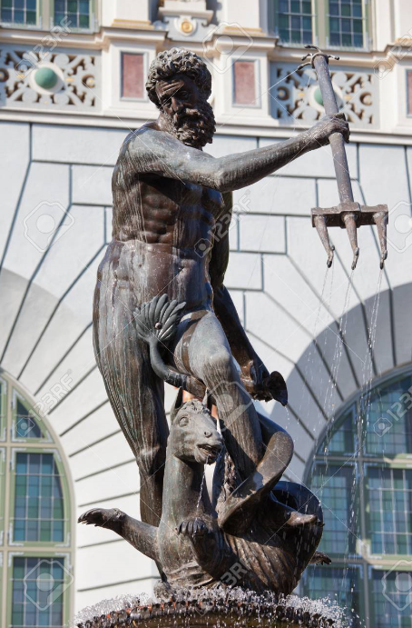
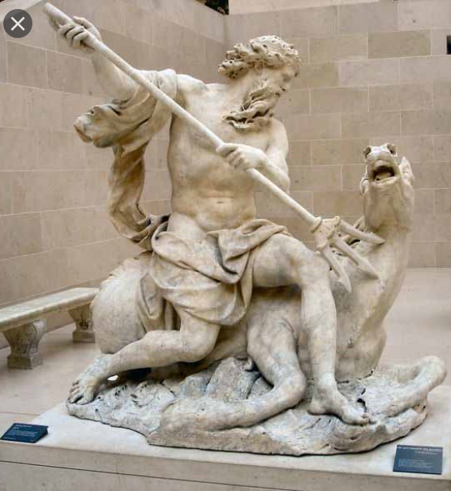
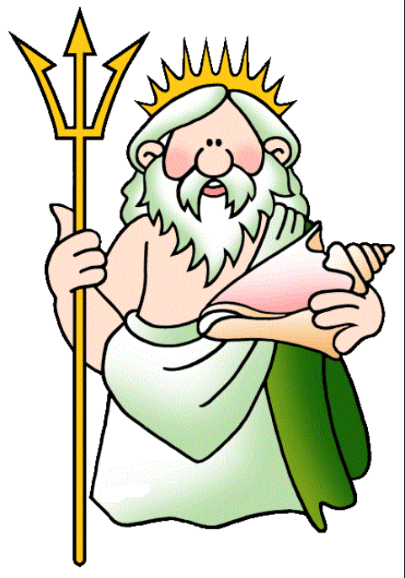
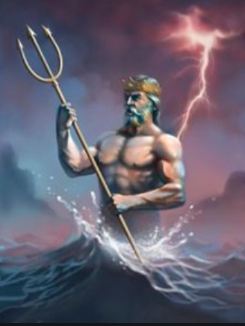
NEPTUNE
Neptune is the God of Water and Sea. He has 2 brothers, Pluto and Jupiter. Normally he is carrying a trident with three sharp spears that he uses for catching fish .

Slide 5
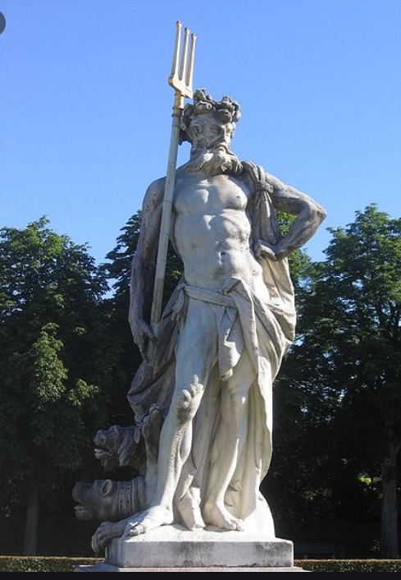
PLUTO
Pluto is the god of death and is the ruler of the underworld. He has two brothers , Jupiter and Neptune. His father was Saturn his main enemy

Slide 6
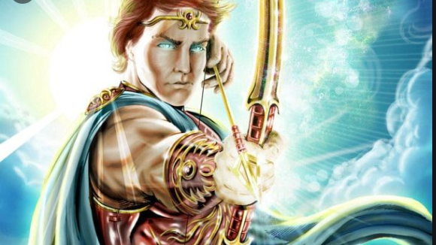
APOLLO
Apollo is the god of sun but he is also god of poetry , art and music . He is the sun of Zeus and Leto . He drove a golden chariot .

Slide 7
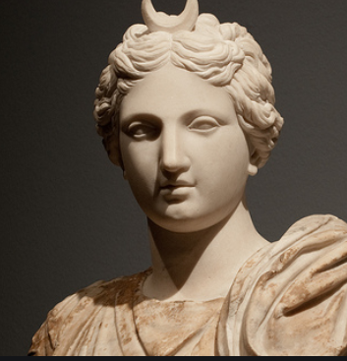
DIANA
Diana is the goddess of the moon, she is the twin sister of Apollo, she is also goddess of the hunt and has a bow.

Slide 8
VENUS
Venus is the goddess of love and beauty. She was very important as her son Aeneas fled from Troy to Italy . She is thought to be the mother of Rome

Slide 9
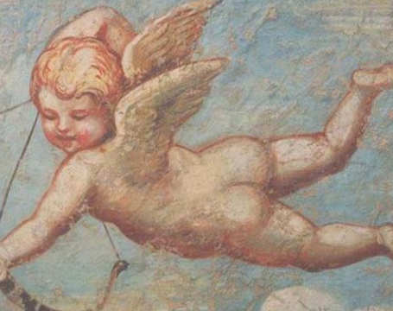
CUPID
Cupid is the god of love . His symbol is a bow and arrow his parents are mars and Venus .

