Slide 1
Eggcellent Entertainers

Slide 2
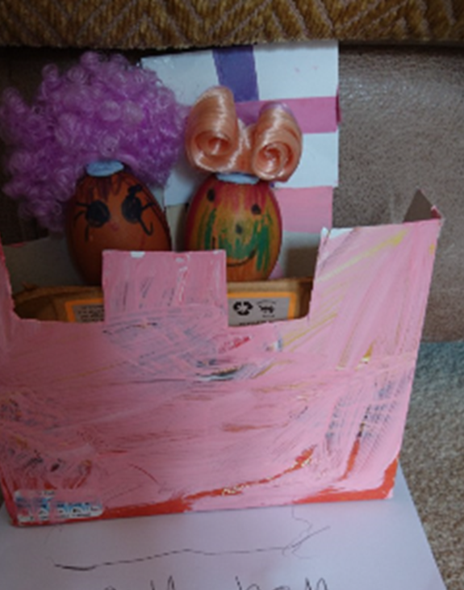
I love the hairstyles Evelyn has given her eggs!

Slide 3
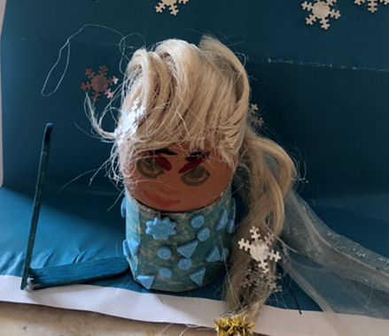
Hollie has gone for a Frozen theme

Slide 4
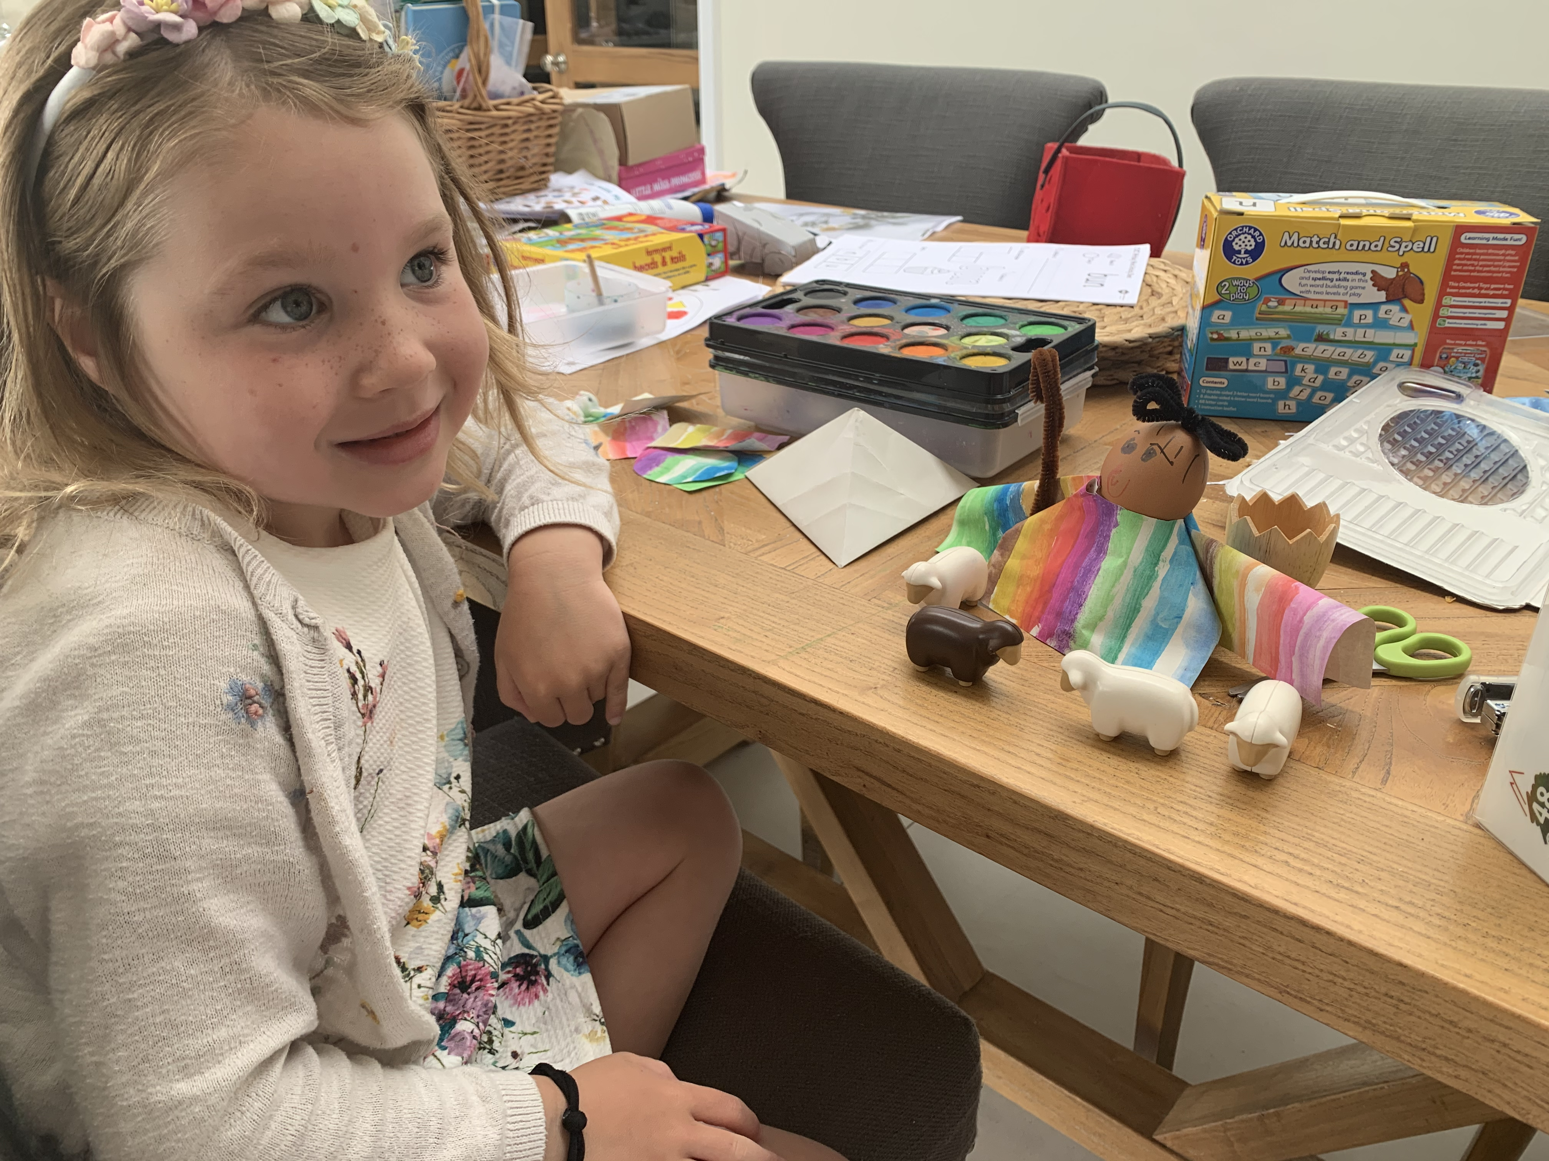
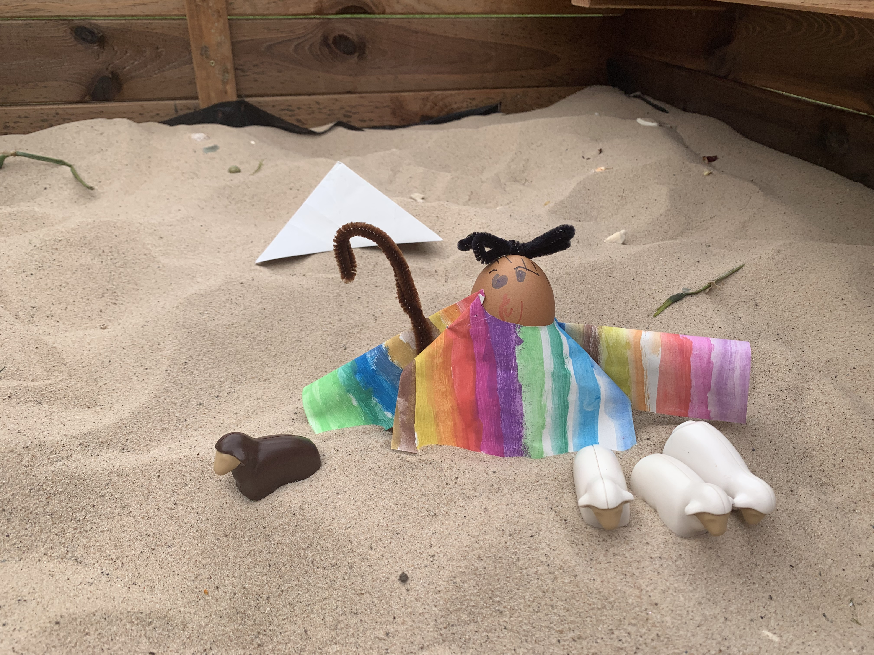
Amelia thought carefully about how to design her Technicolour Dreamcoat

Slide 5

Well done all of you – I cannot choose so you are all winners!!
This Photo by Unknown Author is licensed under CC BY-NC

